Slide 1
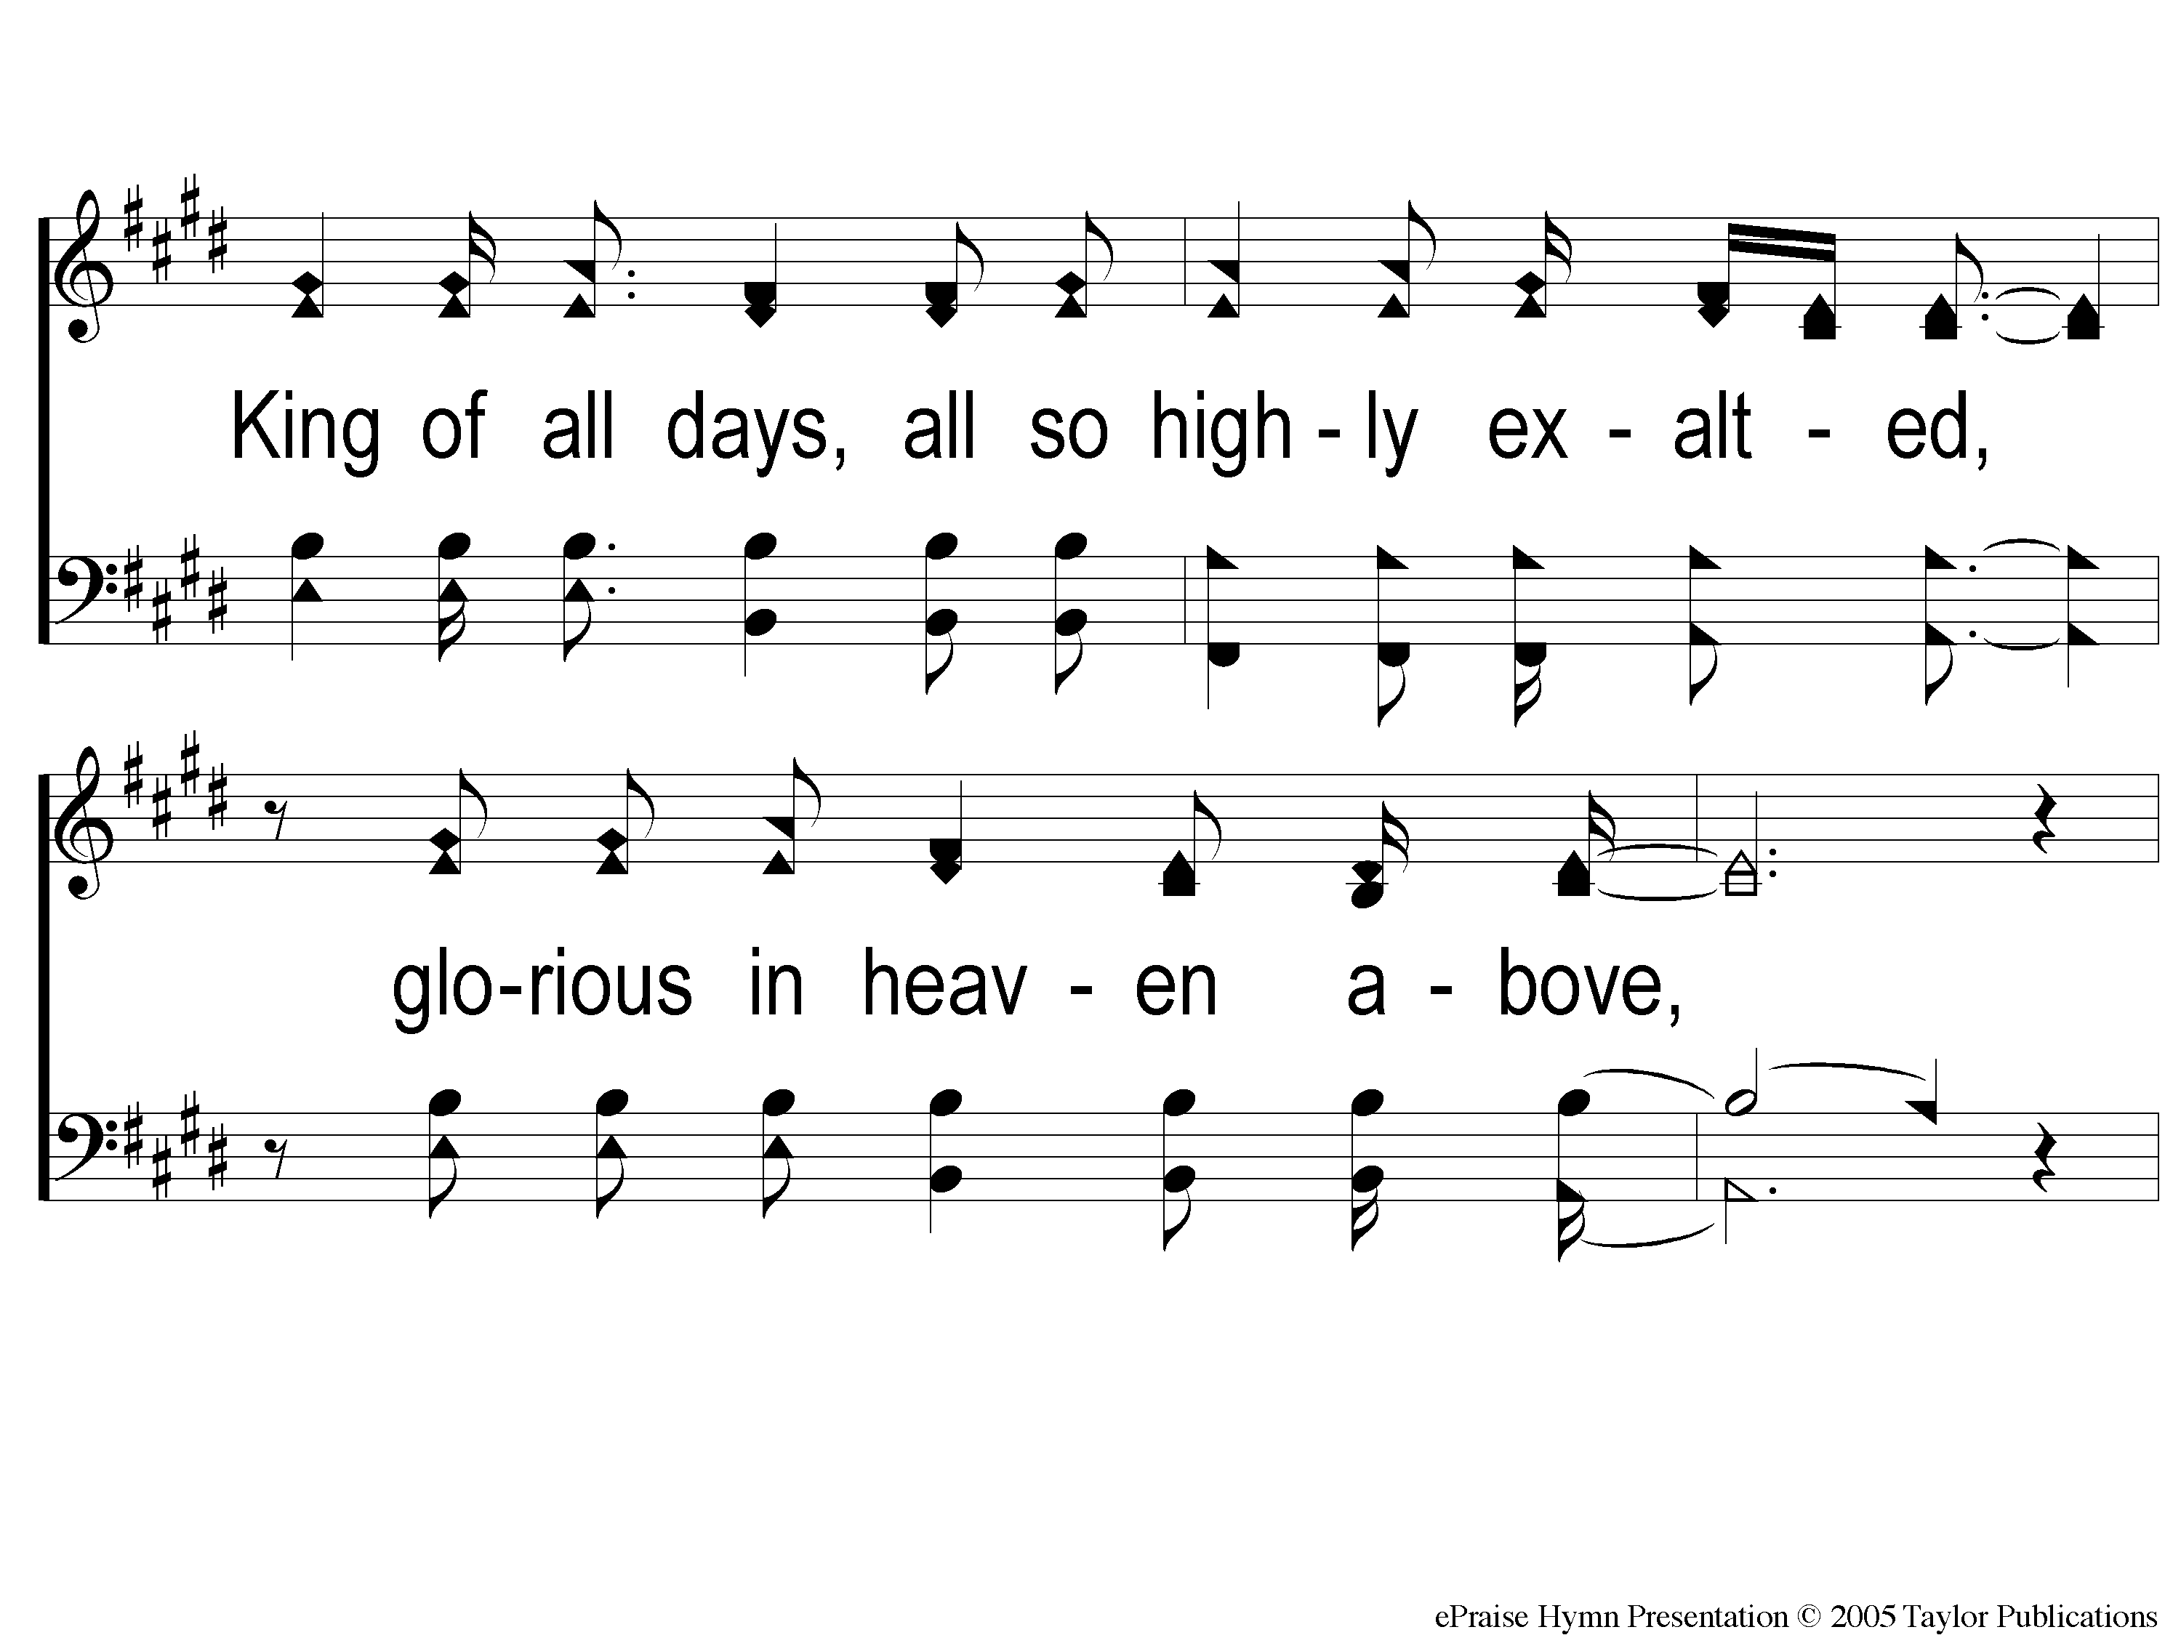
2-1 Here I Am To Worship
Here I Am To Worship

Slide 2
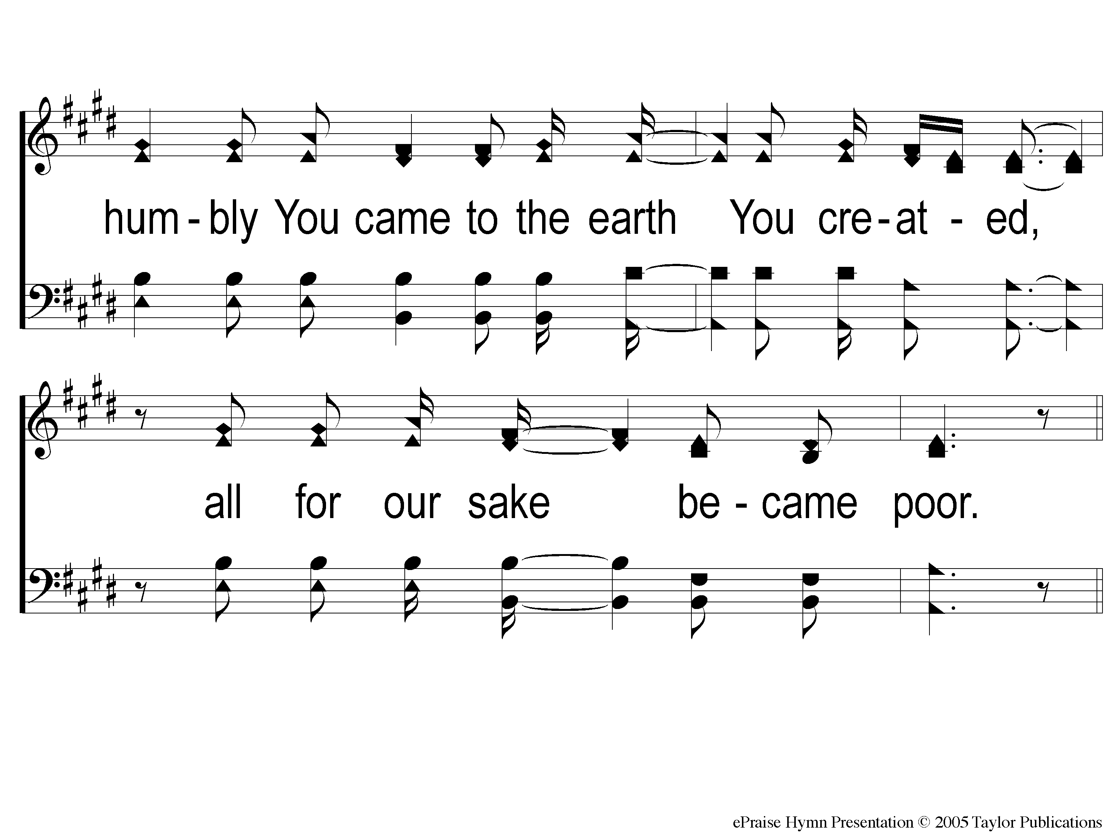
2-2 Here I Am To Worship
Here I Am To Worship

Slide 3
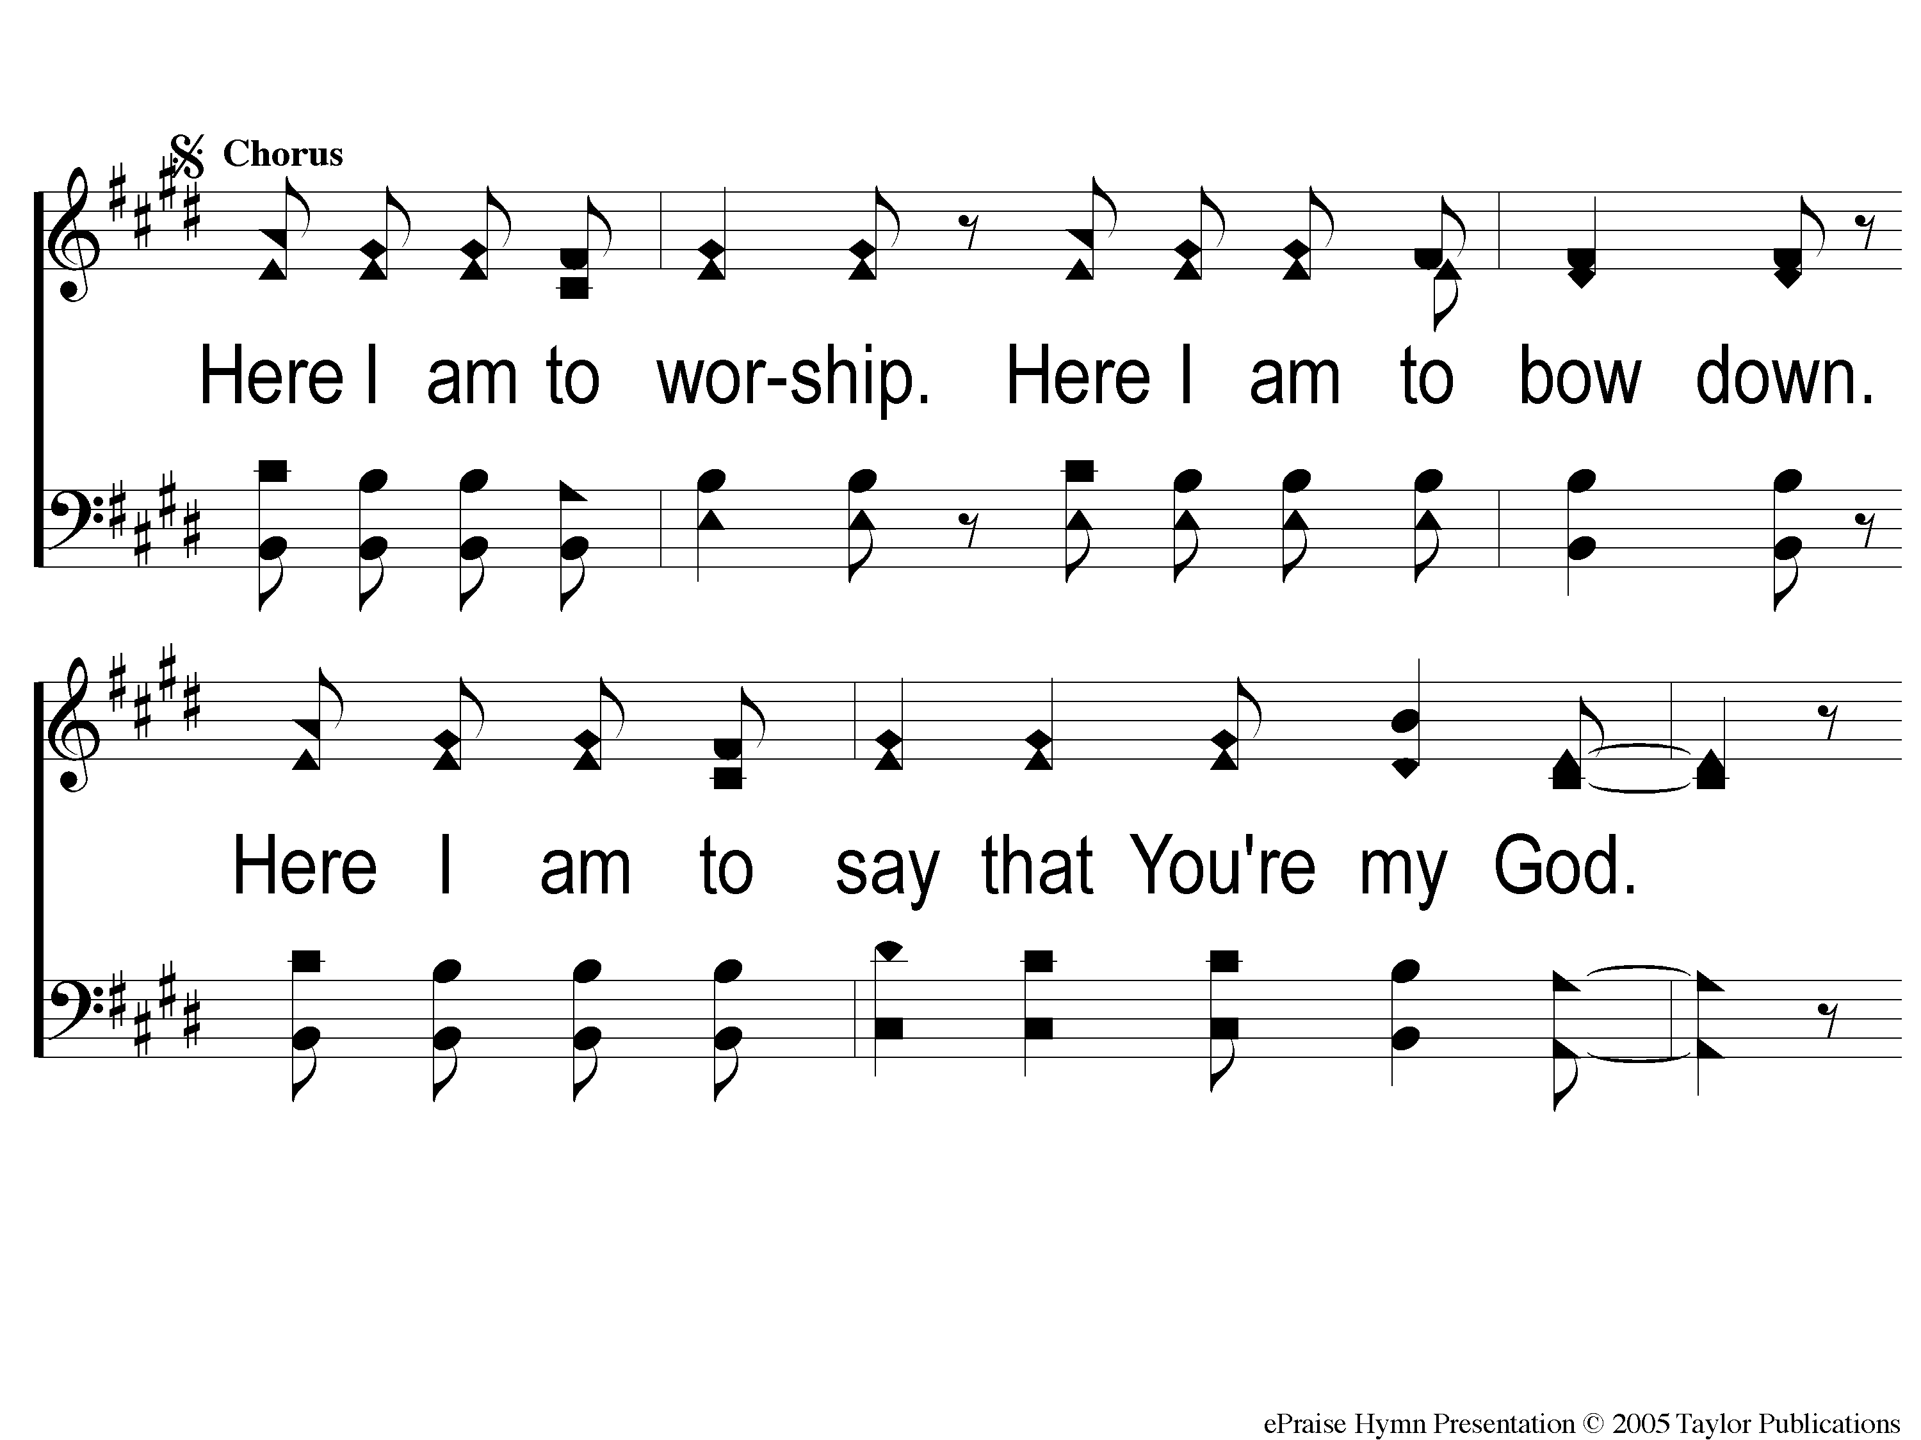
C2-1 Here I Am To Worship
Here I Am To Worship

Slide 4
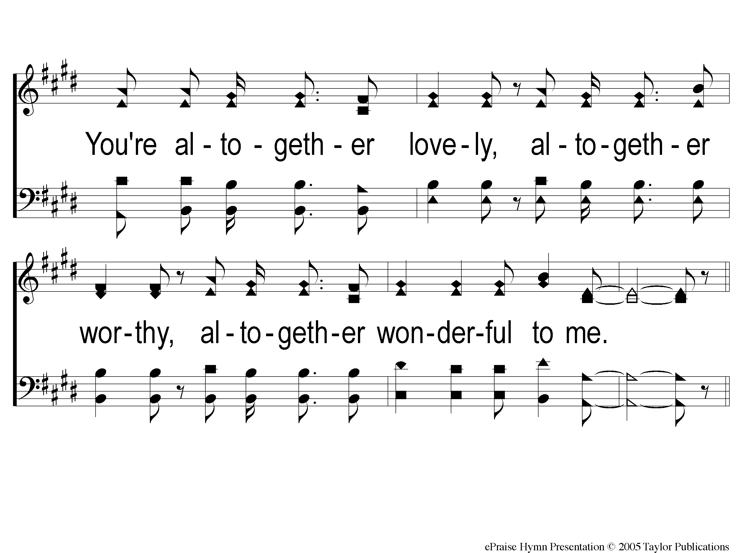
C2-2 Here I Am To Worship
Here I Am To Worship

Slide 5
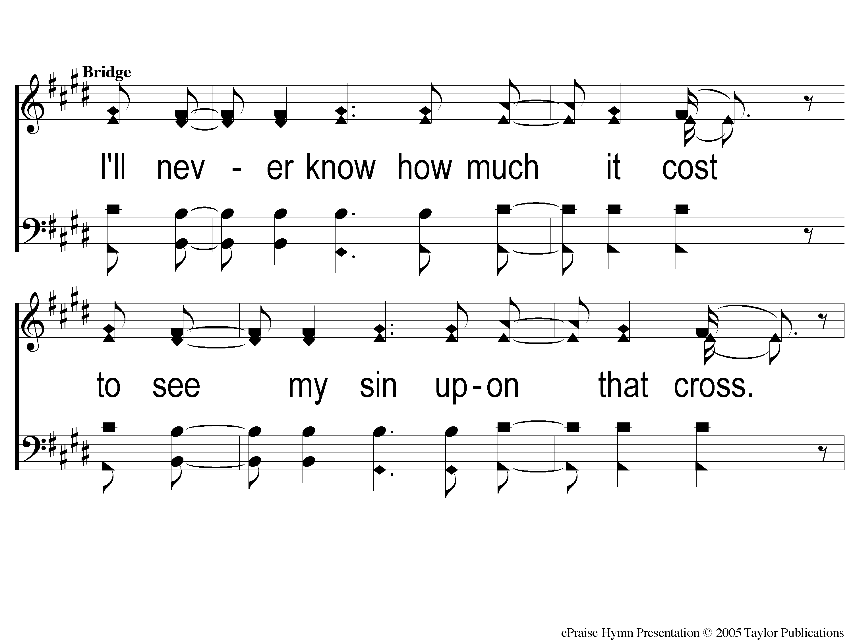
Bridge1 Here I Am To Worship
Here I Am To Worship

Slide 6
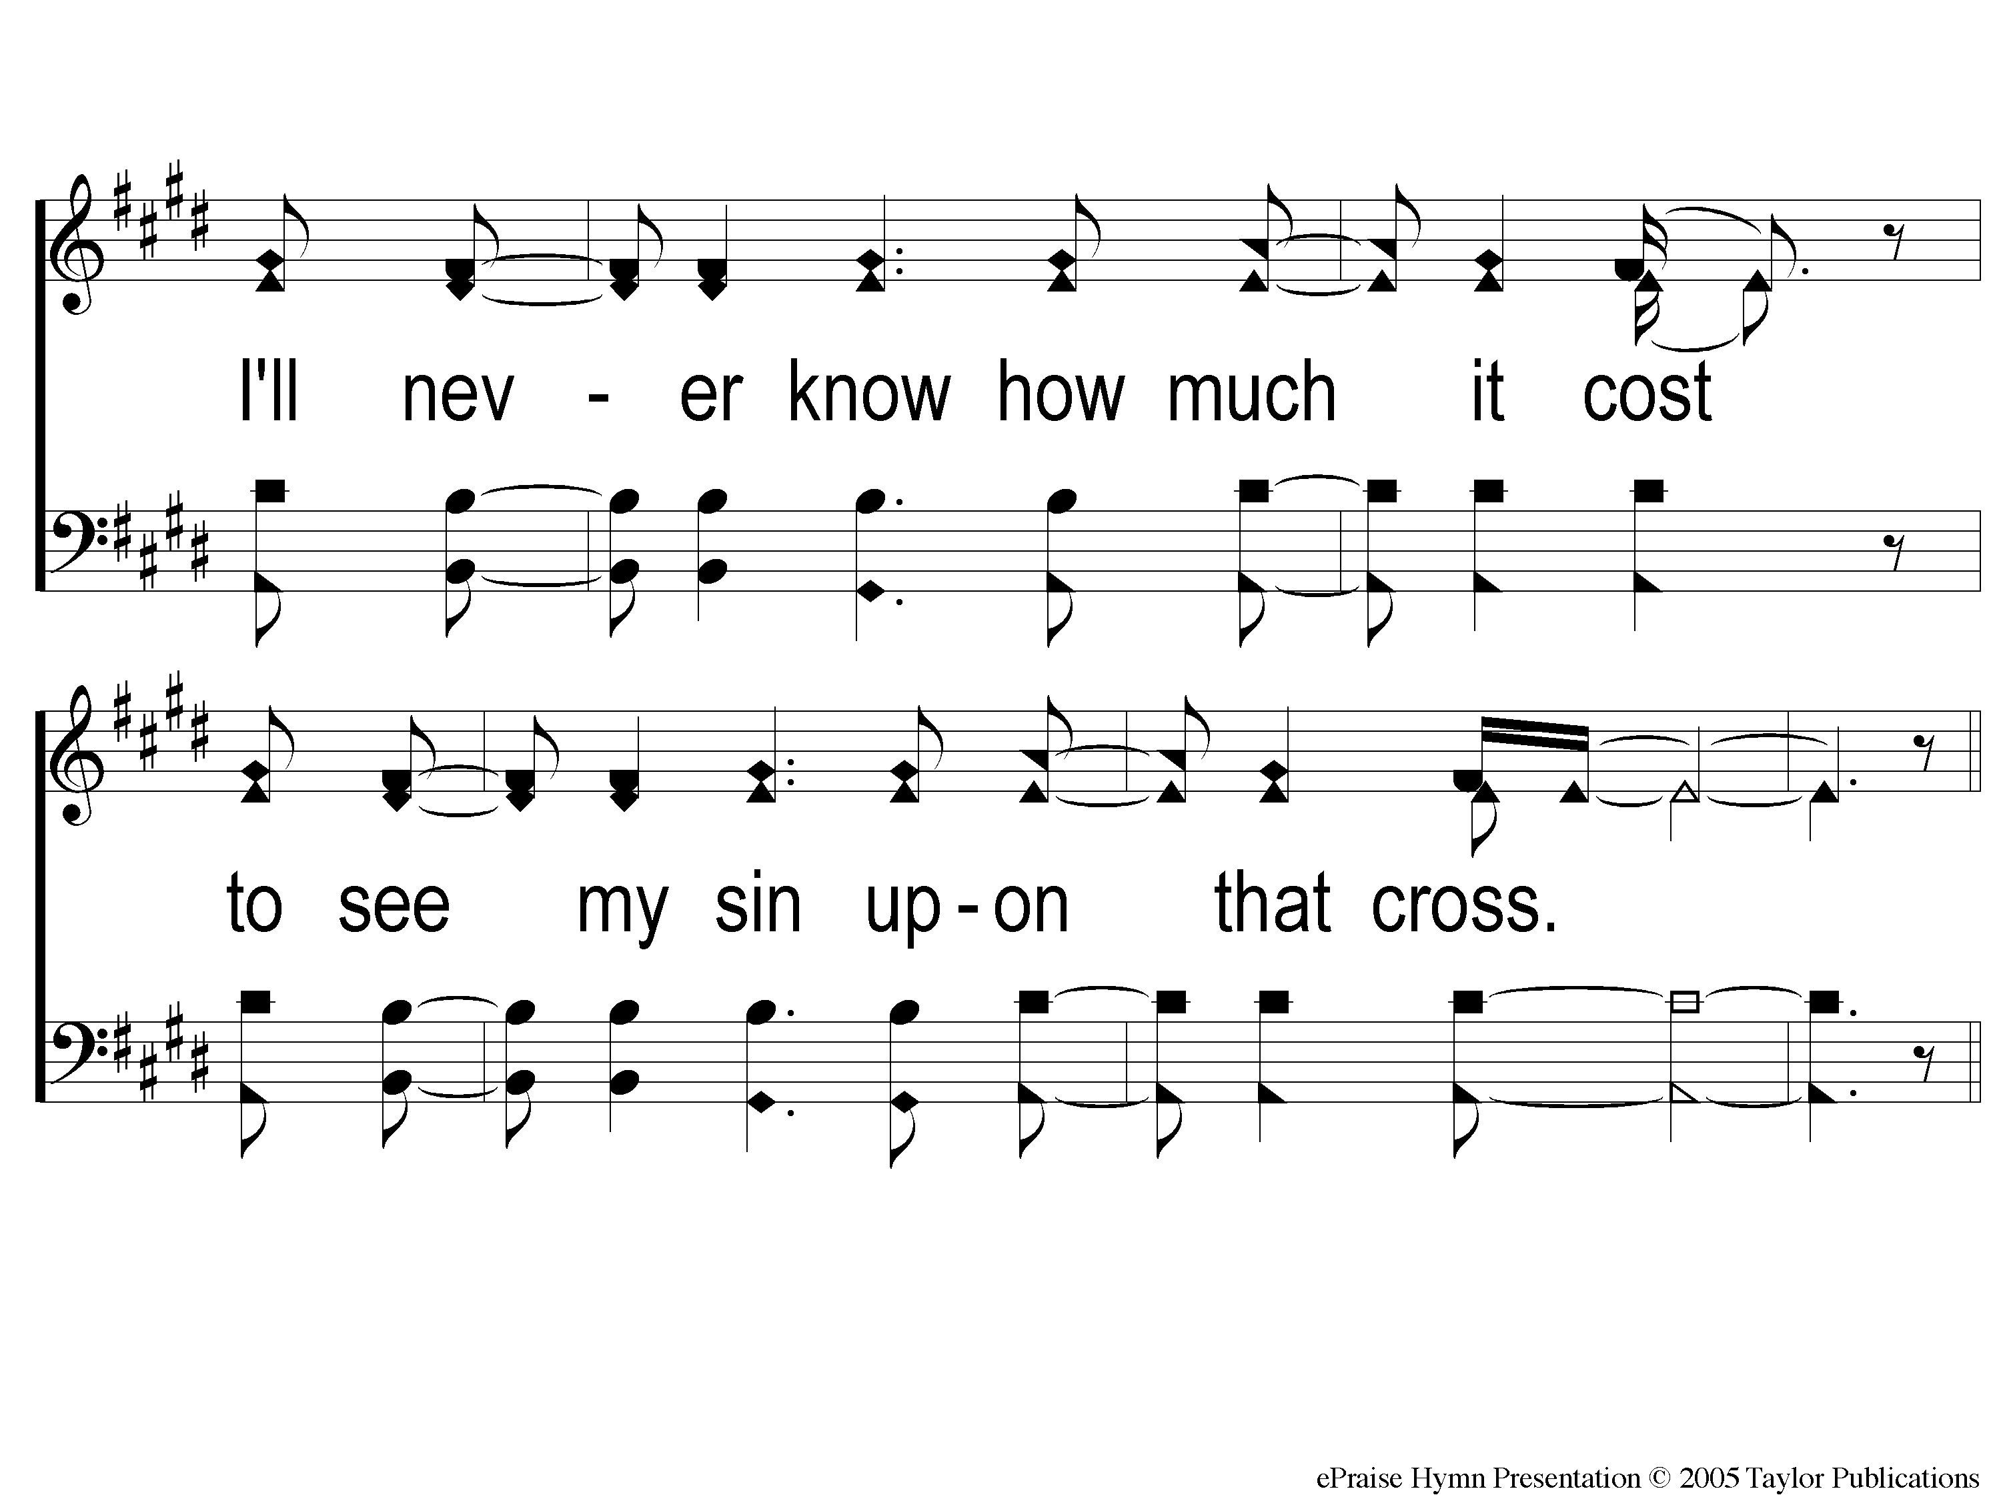
Bridge2 Here I Am To Worship
Here I Am To Worship

Slide 7
C2-1 Here I Am To Worship
Here I Am To Worship

Slide 8
C2-2 Here I Am To Worship
Here I Am To Worship

Slide 9
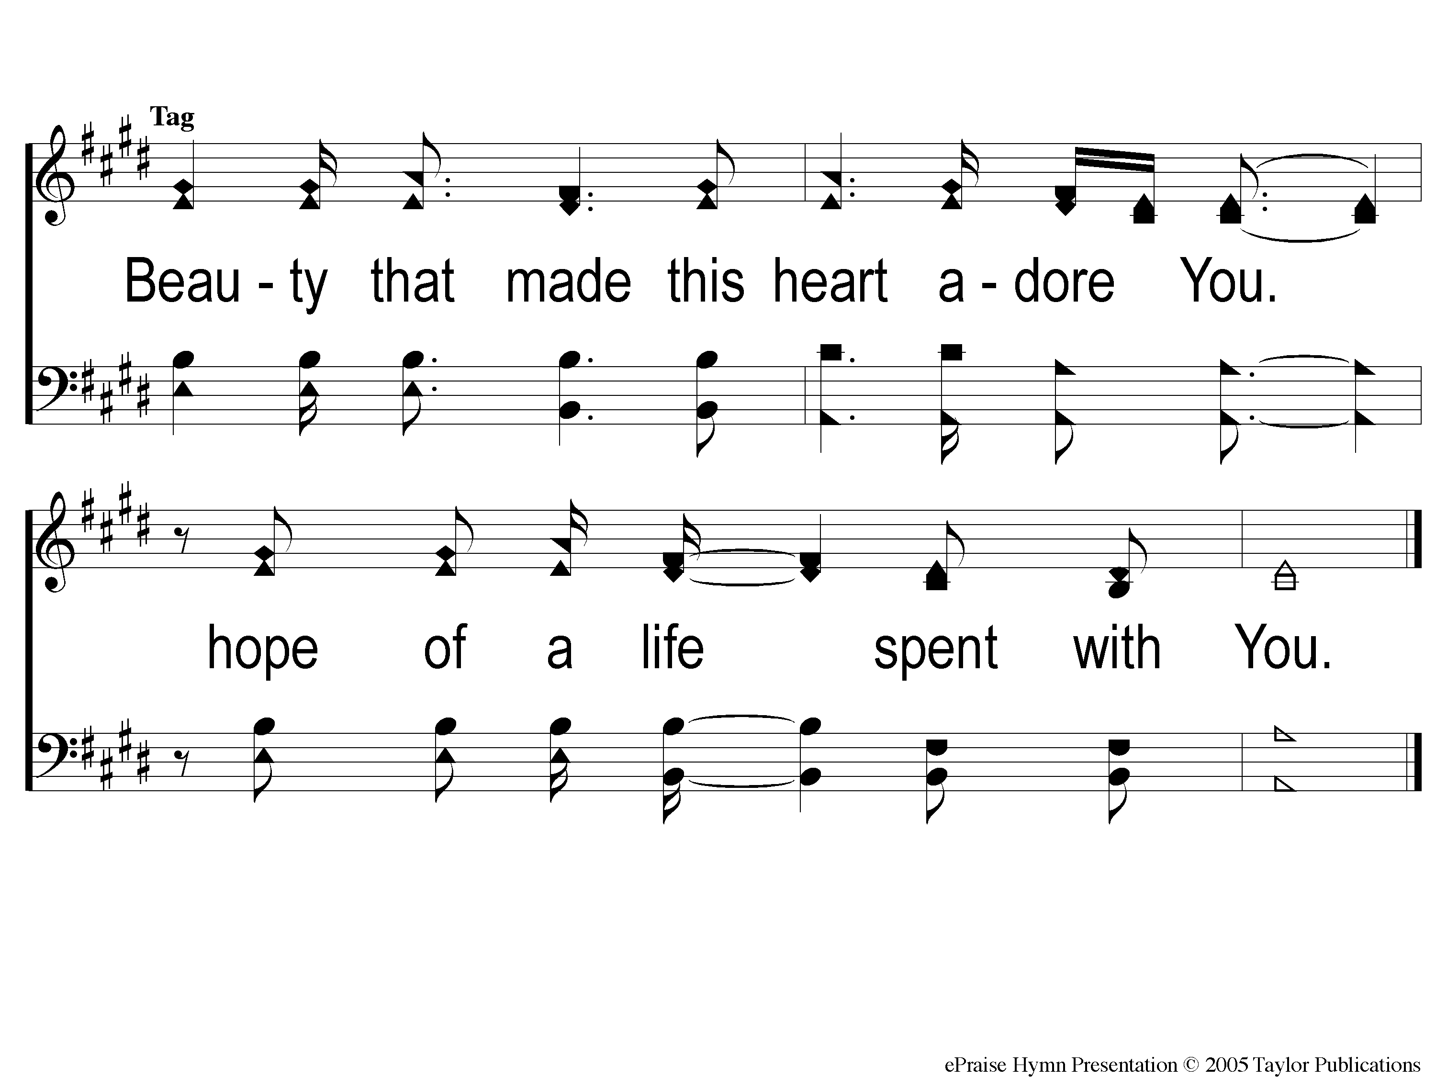
tag Here I Am To Worship
Here I Am To Worship

